Slide 1

Film Industry Strategy for a New Studio Data-Driven Insights to Guide Business Decisions
This Photo by Unknown Author is licensed under CC BY-NC

Slide 2
agenda
BUSINESS UNDERSTANDING 3
DATA ANALYSIS 3
VISUAL AIDS 4
RECOMMENDATIONS 9
CONCLUSIONS 10

Slide 3
BUSINESS UNDERSTANDING This project is aimed to help start a new movie studio that will play as a huge competitive player with the big companies. As big companies increasingly invest in original content, the entertainment landscape is rapidly evolving and its time we evolve with it. At the end of this project, you will get to know all about the movie industry and be able to start one..

Slide 4
DATA UNDERSTANDING
Data Source
The data used in this project comes from three main sources:
1.Box Office Mojo (bom.movie_gross.csv) This is a compressed CSV file containing box office performance data for a wide range of films. It includes both domestic and international gross earnings by year and studio
2.IMDb SQLite Database (im.db.zip) This is a zipped SQLite database that contains metadata and user rating information for movies. The relevant tables, movie_basics and movie_ratings, were merged to support deeper insights.
3.The Numbers Table (tn.movie_budget.csv) This dataset provides detailed financial performance metrics for films, especially focusing on production costs and box office returns.
Reasons why this Data is sufficient for Analysis
These data sources are appropriate for analyzing the business problem because they combine financial performance metrics with audience and film metadata. his allows us to identify trends in what types of films are both commercially successful and well-received by viewers—critical insights for a company looking to make informed decisions about the kinds of films their new studio should produce.

Slide 5
DATA PREPARATION
The data required cleaning, integration, and preparation steps:
Inspection of Dataset Structure: Reviewed shapes, column names, and data types to understand the structure of each dataset.
Handling Missing Values: Identified and addressed missing values using appropriate techniques such as dropping nulls or imputing where necessary.
Data Type Conversion: Converted monetary columns from strings (with dollar signs and commas) to numeric formats for computation.
Date Parsing: Transformed release date strings into datetime objects and extracted year values for time-based analysis.
Duplicate Removal: Checked for and confirmed the absence of duplicate rows.
Profit Calculation: Created new columns (e.g., profit) by subtracting production budgets from gross earnings.
Merging datasets to enrich the data, combining relevant information across files based on common keys such as movie titles and years.
Saving Cleaned Data: Exported cleaned versions of key datasets to CSV files for later use.

Slide 6
DATA ANALYSIS
This analysis aims to identify what types of films are currently performing best at the box office and which studios are the best to guide our new movie studio's content strategy. We'll examine four key relationships:
Genre Popularity & TrendsWhy These Matter- Determine which genres are most profitable (highest revenue) and most appreciated by audiences (highest ratings)
2. Studio Performance Analysis- Studio perfomance helps a new movie studio identify, succesful production and distribution partners and potential competitive positioning.
3. Audience Preferences Analysis- Understand the relationship between ratings and revenue to balance artistic quality and commercial success.
4. ROI Analysis- ROI (Return on Investment) matters because it shows how efficiently money is being used to generate profit.
Expected Insights
By the end of this analysis, we'll provide actionable recommendations on:
1.Which genres to prioritize for production.
2.Which studios are most successful.
3.Do high ratings lead to higher revenue.
4.Return efficiency relative to cost.

Slide 7
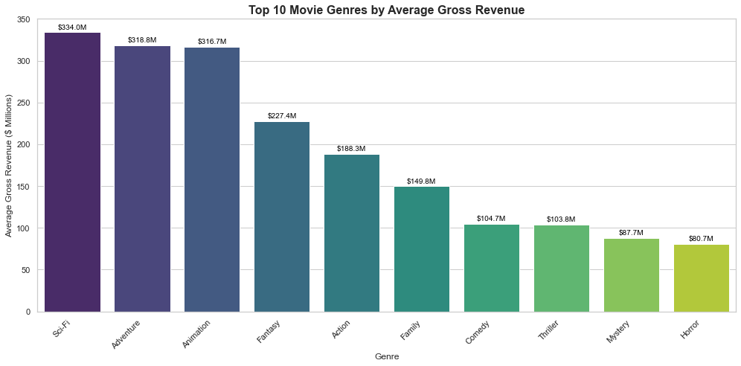
GENRES BY AVERAGE GROSS
OBSERVATIONs
The top 3 genres with best gross revenue are:
Sci-fi
Adventure
Animation
While the least gross revenue
Horror
Mystery
Thriller
FINDINGS
Sci-fi, adventure and animation have the highest return and it would be the best genres to begin with from the data collected for a successful movie studio.
Horror, mystery and thriller have the poorest return And this may not be a very good option for genres to start with as they don’t have high returns.

Slide 8
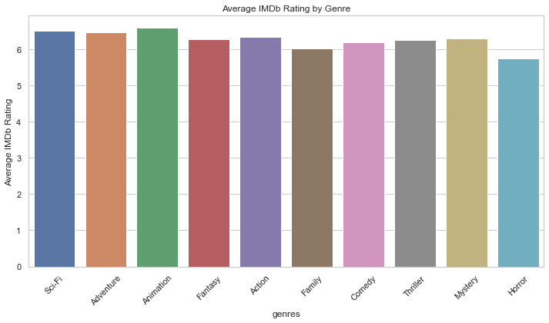
Genres by average IMDb Rating
OBSERVATIONS
From the bar graph we can see that all genres are doing fairly good as the IMDb rating is close to one another but we can still see animation, adventure and sci-Fi with one of the best IMDbs
FINDINGS
Animation, sci-Fi and adventure have the best IMDbs and I recommend to go with them as start up genres for the new movie studio and a successful one.

Slide 9
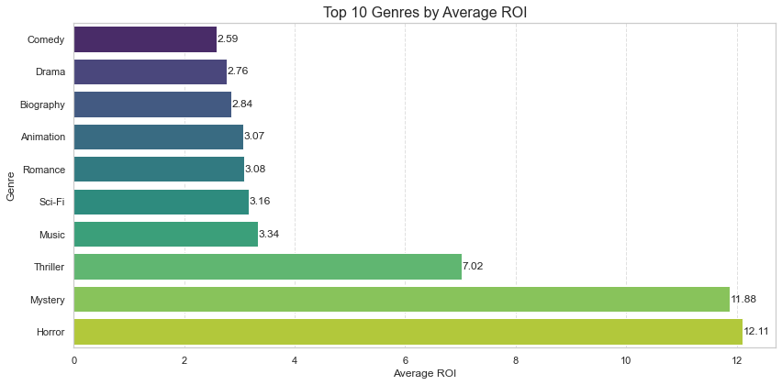
Genre by Average ROI
FINDINGS
Genres with the highest ROI are:
Horror
Mystery
Thriller
And lowest ROI are:
Comedy
Drama
Biography
FINDINGS
Horror, Mystery and Thriller have the best ROI making them stand out as the best genres to start with as a successful upcoming movie studio while genres such as comedy, drama and biography have poor ROI

Slide 10
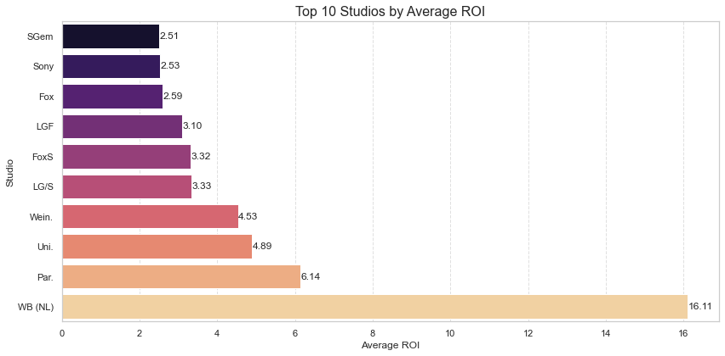
AVERAGE ROI BY STUDIO
OBSERVATIONS
Studio with best average ROI are:
WB(NL)
Par
Uni.
Studios with poor average ROI are:
SGem
Sony
FOX
FINDINGS
WB(NL),Par.,Uni.

Slide 11
RECOMMENDATIONS
Focus on High-Performing Genres: Prioritize Sci-Fi, Adventure, and Animation for production, as these genres show the highest profitability and audience appeal.
Adopt a Balanced Production Strategy: Combine big-budget blockbusters (for revenue) with critically acclaimed, lower-budget projects (for reputation and awards).
Target High-ROI Genres: Invest in genres like Horror and Mystery, which deliver strong returns relative to budget and appeal to broad audiences.
Partner with Top Studios: Collaborate with studios that consistently achieve high revenue and ROI (e.g., P/DW, BV, WB(NL)) to leverage their production and marketing expertise.
Optimize Release Timing: Schedule major releases during peak seasons (summer, holidays) to maximize box office potential.
Build a Data-Driven Culture: Continuously monitor audience trends, ratings, and financial metrics to refine strategies and stay competitive.

Slide 12

CONCLUSIONS
The analysis reveals:
1. Sci-Fi, Adventure, and Animation are the best genres for profitability and audience appeal.
2. Partnering with top-performing studios can enhance production quality and distribution.
3. Balancing revenue and ratings requires a mixed strategy—focusing on blockbusters for income and critically acclaimed projects for reputation.
4. The correlation matrix shows weak linear relationships between most numerical features, though vote count and runtime show minor interaction.
5. Genres with high ROI (e.g. Horror & Mystery) tend to deliver strong returns relative to budget. These genres are often low to mid-budget with broad audience appeal, making them smart investment targets.
6. Studios with high ROI(e.g., WB(NL)) demonstrate effective cost control and marketing strategies. Partnering with or emulating the production practices of these studios could enhance profitability
This Photo by Unknown Author is licensed under CC BY-SA

Slide 13
Thank you
AUTHORS
David clement
Kungu WaKAIMBA
Olive njeri
Steve opar
Mercy chepkorir
Kelly kihige
Brought to you by group 4

